Slide 1
Chapter 6 Counting
6.1 The Basic of Counting
6.2 The Pigeonhole Principle
6.3 Permutations and Combinations
6.4 Binomial Coefficients
6.5 Generalized Permutations and Combinations
6.6 Generating Permutations and Combinations

Slide 2
6.5 Generalized Permutations and Combinations
1. Introduction
r-permutation, r-combination with no repetition allowed
r-permutation, r-combination with repetitions allowed

Slide 3
6.5 Generalized Permutations and Combinations
2. Permutations with Repetition
【Definition 1】r-permutation with repetition
r-permutations of a set with repetition allowed.
【 Theorem 1】 The number of r-permutations of a set of n
objects with repetition allowed is n^{r}.
For example,
How many strings of length 10 can be formed from the English alphabet?
26¹⁰

Slide 4
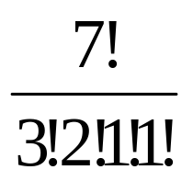
6.5 Generalized Permutations and Combinations
3. Permutations with Indistinguishable Objects
For example,
How many different strings can be made by reordering the letters of the word SUCCESS?
C(7, 3) C(4, 2) C(2, 1) C(1, 1) =
【Definition 2】 n-Permutation with limited repetition
A = { n_{1•} a₁ ,n_{2 •} a₂ ,…,n_{k •} a_{k} } ，where n₁+n₂+…+n_{k} = n

Slide 5
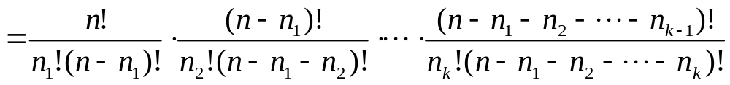
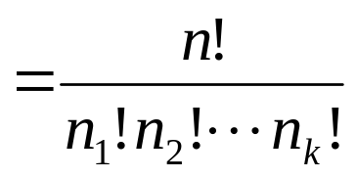
6.5 Generalized Permutations and Combinations
【 Theorem 2 】 The number of different permutations of n
objects, where there are n₁ indistinguishable objects of
type1, …, and n_{k} indistinguishable objects of type k, is
n!/(n₁!n₂!…n_{k}!)
…...
□ □ □ □ □ □ □ …… □ □
Proof:

Slide 6
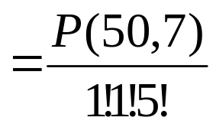
6.5 Generalized Permutations and Combinations
〖Example 1〗There are 50 students in a class.
How many ways to select 7 students to construct a leading group?
If two of the leading group are elected as a monitor and a vice monitor, then how many are there?
If these 7 students are elected to have different tasks, then how many are there?
C(50,7)
P(50,7)

Slide 7
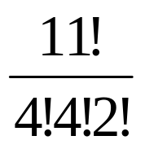
6.5 Generalized Permutations and Combinations
〖Example 2〗
  How many bit strings of length 10？
  How many bit strings of length 10 are there that contain exactly two 0s, eight 1s?
2¹⁰
10!/(2!8!)
〖Example 3〗How many different strings can be made from
the letters in MISSISSIPPI, using all the letters?
Solution:
A = { 1• M ,4 • I, 4 • S, 2 • P}

Slide 8

6.5 Generalized Permutations and Combinations
【Definition 3】 r- Circle Permutation
【 Theorem 3 】 The number of r- Circle permutations of a
set of n objects is P(n,r)/r .
For example,
1
2
5
1
5
4
3
2
4
3
〖Example 4〗How many ways are there to seat seven people
around a circular table?

Slide 9
6.5 Generalized Permutations and Combinations
4. Combinations With Repetition
【Definition 4】 r-Combination with repetition
〖Example 6〗Suppose that a cake shop provides 2 different kinds of cakes. How many different ways can 3 cakes be chosen?
Question:
How many different ways with at least one of each kind?

Slide 10
6.5 Generalized Permutations and Combinations
【 Theorem 4 】 There are C (n-1+r, r) r-combination from a
set with n elements when repetition of elements is allowed.
Proof:
 The n-1 bars are used to mark off n different cells, with the ith cell containing a star for each time the ith element of the set occurs in the combination.
For example,
* * | * | | * | * * *
Each r-combination of a set with n elements when repetition is allowed can be represented by a list of n-1 bars and r stars.
The number of such lists is C (n-1+r, r).

Slide 11
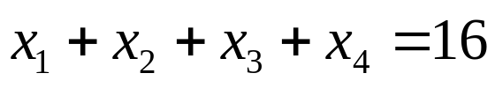

6.5 Generalized Permutations and Combinations
〖Example 7〗How many solutions are there to the equation
where is nonnegative integer?
Solution:
Since a solution of this equation corresponds to a way of
selecting 16 items from a set with four elements so that x₁
items of type one, x₂ items of type two, x₃ items of type three,
x₄ items of type four are chosen.
Hence the number of solutions is
C (4-1+16, 16) = C (19, 16)
= C (19, 3)

Slide 12
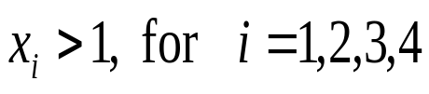

6.5 Generalized Permutations and Combinations
〖Example 7〗How many solutions are there to the equation
where is nonnegative integer?
Question:
x_{i}≥2
(1)
C (4-1+8, 8) = C (11, 8) = C (11, 3)
(2)
We can introduce an auxiliary variable x₅ so that
x₁ + x₂ + x₃+ x₄ +x₅ =16
C (5-1+16, 16) = C (20, 16) = C (20, 4)

Slide 13
6.5 Generalized Permutations and Combinations
5. Distributing objects into boxes
1) Distinguishable objects and distinguishable boxes
【 Theorem 5 】 The number of ways to distribute n
distinguishable objects into k distinguishable boxes so that
n_{i} objects are place into box i, i=1,2,…,k, equals
n!/(n₁!n₂!…n_{k}!)

Slide 14
6.5 Generalized Permutations and Combinations
〖Example 8〗How many ways are there to distribute hands of 5 cards to each of four players from the standard deck of 52 cards?
Solution:
It is a typical problem that involves distributing distinguishable objects into distinguishable boxes.
- The distinguishable objects are the 52 cards.
- The five distinguishable boxes are the hands of the four players and the rest of the deck.

Slide 15
6.5 Generalized Permutations and Combinations
2) Distinguishable objects and indistinguishable boxes
-counting the ways to place n distinguishable objects into k indistinguishable boxes

Slide 16
6.5 Generalized Permutations and Combinations
〖Example 9〗How many ways are there to put four different employees into three indistinguishable offices, when each office can contain any number of employees?
Solution:
We represent the four employees by A,B,C,D.
(1) All four are put into one office: 1 ways {A,B,C,D}
(2) Three are put into one office and a fourth is put into a second office:
4 ways {{A,B,C},{D}}; {{A,B,D}, {C}}; {{A,C,D}, {B}}; {{B,C,D}, {A}}
(3) Two are put into one office and two put into a second office:
3 ways {{A,B},{C,D}}; {{A,D},{B,C}}; {{A,C},{B,D}}
(4) Two are put into one office, and one each put into the other two office:
6 ways
{{A,B},{C},{D}}; {{A,C},{B},{D}}; {{A,D},{B},{C}}; {{B,C},{A},{D}};
{{B,D},{A},{C}}; {{C,D},{A},{B}}

Slide 17
6.5 Generalized Permutations and Combinations
〖Example 9〗How many ways are there to put four different employees into three indistinguishable offices, when each office can contain any number of employees?
Solution:
There are 1+4+3+6=14 ways to put four different employees into three indistinguishable offices.
Another way:
Look at the number of offices into which we put employees.
There are 6 ways to put four different employees into three indistinguishable offices so that no office is empty.
There are 7 ways to put four different employees into two indistinguishable offices so that no office is empty.
There are 1 ways to put four different employees into one offices so that it is not empty.

Slide 18
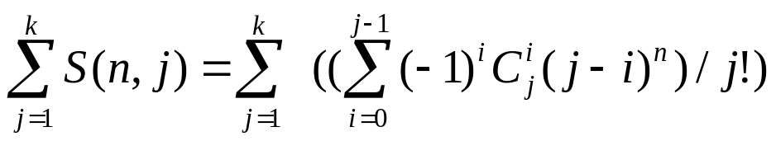
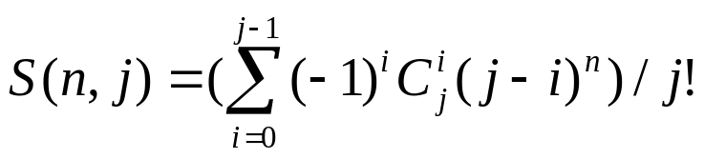
6.5 Generalized Permutations and Combinations
S(n,j): Stirling numbers of the second kind
- the number of ways to distribute n distinguishable objects into j indistinguishable boxes so that no boxes is empty
S(r,1)=S(r,r)=1 (r≥1)
S(r,2)=2^{r-1}-1
S(r,r-1)=C(r,2)
S(r+1,n)=S(r,n-1)+nS(r,n)
the number of ways to place n distinguishable objects into k indistinguishable boxes
Note:
S(n,j) is the number of ways to partition the set with n elements into j nonempty and disjoint subsets.

Slide 19
6.5 Generalized Permutations and Combinations
〖Example 9〗How many ways are there to put four different employees into three indistinguishable offices, when each office can contain any number of employees?
Solution:
There are 1+4+3+6=14 ways to put four different employees into three indistinguishable offices.
Another way:
Look at the number of offices into which we put employees.
There are 6 ways to put four different employees into three indistinguishable offices so that no office is empty.
There are 7 ways to put four different employees into two indistinguishable offices so that no office is empty.
There are 1 ways to put four different employees into one offices so that it is not empty.
S(4,3)+S(4,2)+ S(4,1)=6+7+1=14

Slide 20
6.5 Generalized Permutations and Combinations
3) Indistinguishable objects and distinguishable boxes
-counting the ways to distribute n indistinguishable objects into k distinguishable boxes
Same as counting the number of n-combinations for a set with k elements when repetitions are allowed.
For example,
How many ways are there to place 10 indistinguishable balls into eight distinguishable bins?

Slide 21
6.5 Generalized Permutations and Combinations
4) Indistinguishable objects and indistinguishable boxes
-counting the ways to distribute indistinguishable objects into indistinguishable boxes

Slide 22
6.5 Generalized Permutations and Combinations
〖Example 10〗How many ways are there to pack six copies of the same book into four identical boxes, where a box can contain as many as six books?
Solution:
We can enumerate all ways to pack the books. For each ways to pack the books, we will list the number of books in the box with the largest of books, followed by the number of books in each box containing at least one book, in order of decreasing number of books in a box.
The ways we can pack the books are
6 5,1
4,2 4,1,1
3,3 3,2,1
3,1,1,1 2,2,2 2,2,1,1

Slide 23
Homework: (Due on April 20)
Ver. 8
Sec. 6.5 10, 16, 28, 34, 48, 52, 56, 63
Ver. 7
Sec. 6.5 10, 16, 26, 32, 46, 50, 54, 61

Slide 24
Chapter 6 Counting
6.1 The Basic of Counting
6.2 The Pigeonhole Principle
6.3 Permutations and Combinations
6.4 Binomial Coefficients
6.5 Generalized Permutations and Combinations
6.6 Generating Permutations and Combinations

Slide 25
6.6 Generating Permutations and Combinations
1. Generating Permutations
Problem:
List the permutations of any set of n elements.
Solution:
Any set with n elements can be placed in one-to-one correspondence with the set {1, 2, …, n}
Generate the permutation of the n smallest positive integers, and then replace these integers with the corresponding elements.

Slide 26
5.6 Generating Permutations and Combinations
The lexicographic ordering of the set of permutations of
{1, 2, …, n}
The permutation a₁a₂…a_{n} precedes the permutation of b₁b₂…b_{n} , if for some k, with 1≤ k ≤ n , a₁ = b₁ , a₂ = b₂ , …, a_{k-1} = b_{k-1} , and a_{k} < b_{k},
For example:
123465 124635

Slide 27
5.6 Generating Permutations and Combinations
Algorithm of producing the n! permutations of the integers
1, 2, …, n
  Begin with the smallest permutation in
  lexicographic order, namely 1234…n .
  Produce the next larger permutation.
  Continue until all n! permutations have been found.

Slide 28



5.6 Generating Permutations and Combinations
Given permutation a₁a₂…a_{n}, find the next larger permutation in increasing order:
(1) Find the integers
(2) Put in the jth position the least integer among
that is greater than
(3) List in increasing order the rest of the integers

Slide 29
5.6 Generating Permutations and Combinations
〖Example 1〗What is the next larger permutation in
lexicographic order after 124653?
The next largest permutation of 124653 in lexicographic order is 125346

Slide 30
5.6 Generating Permutations and Combinations
2. Generating Combinations
Problem 1:
Generate all combinations of the elements of a finite set .
Solution:
A combination is just a subset. ⇒ We need to list all subsets of the finite set.
Use bit strings of length n to represent a subset of a set with n elements. ⇒ We need to list all bit strings of length n.
The 2^{n} bit strings can be listed in order of their increasing size as integers in their binary expansions.

Slide 31
5.6 Generating Permutations and Combinations
Algorithm of producing all bit strings
  Start with the bit string 000…00,with n zeros.
  Then, successively find the next larger expansion until
  the bit string 111…11 is obtained.
The method to find the next larger binary expansion:
  Locate the first position from the right that is not a 1,
  then changing all the 1s to the right of this position to 0s
  and making this first 0 a 1.
  For example:
  1000110011 → 1000110100

Slide 32





5.6 Generating Permutations and Combinations
Problem 2:
Generate all r-combinations of the set {1, 2, …, n}
The algorithm for generating the r-combination of the set {1, 2, …, n}
(1) S₁ = {1, 2, …, r}
(2) If has found, then the next combination can be obtained using the following rules.
First, locate the last element in the sequence such that
. Then replace with and with

Slide 33
5.6 Generating Permutations and Combinations
〖Example 2〗 S_{i} ={2,3,5,6,9,10} is given from the set {1,2,3,4,5,6,7,8,9,10}. Find S_{i+1} .
Solution:
S_{i+1} ={2,3,5,7,8,9}

Slide 34
Homework: (Due on April 20)
Ver. 7 & 8
Sec. 6.6 6(f), 7, 9

